Slide 1
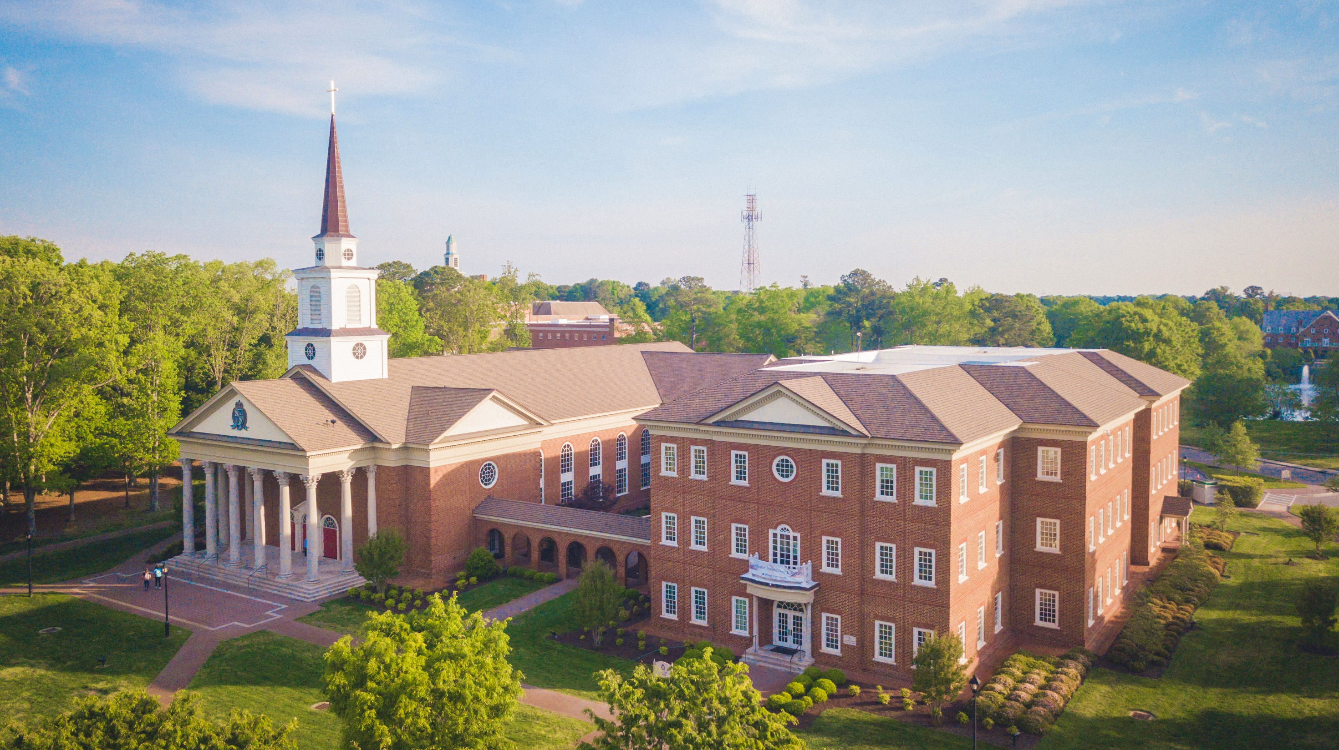

Event Leadership Training
Set Up Your Successor Training
2025-2026 Student Organization Leaders
for student organizations
fall 2022

Slide 2

Equipped to Lead

Slide 3
Equipped to Lead
This PowerPoint will provide an overview of helpful resources available to student organizations leaders:
Event Procedures & Forms
Fundraising
Financial & Budgeting
Marketing
Tips for facilitating a successful meeting.
Charter Renewal Process
L.E.A.D

Slide 4
Introductions
There are 4 faculty/staff members to identify:
Director, Student Engagement
Assistant Director, Student Engagement
Faculty Advisor (Budget Manager)
Logistics Manager

Slide 5
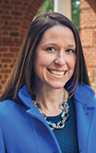
Jenn Gribble
Director, Student Engagement
Oversees student organization activities and policies
Manages the charter renewal process
Maintains list of valid student organizations
Provides approval for all student org events, guest speakers, and social media accounts

Slide 6
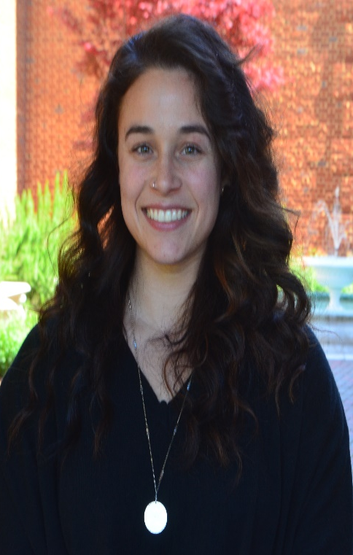
Nicole Jackson
Assistant Director , Student Engagement
Assists director with student organization activities and policies
Helps with the charter renewal process
Maintains list of valid student organizations
Assists and provides approval for all student org events, guest speakers, and social media accounts

Slide 7
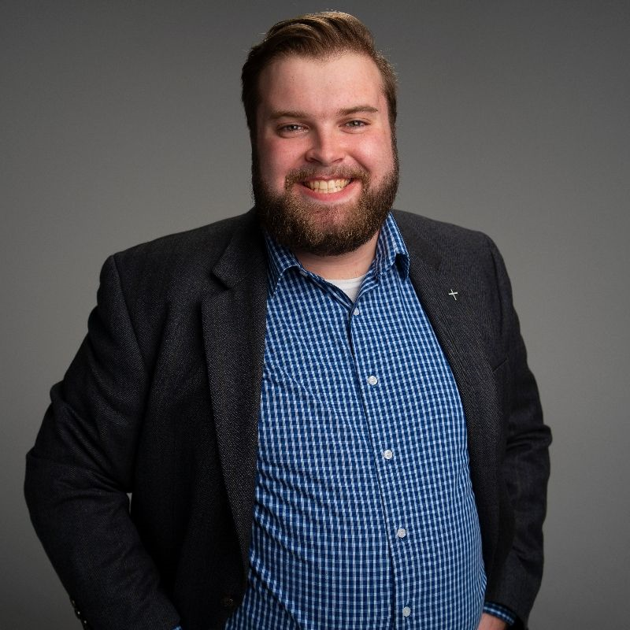
Ryland Murphy
Logistics Manager
Primary point of contact for all student org event planning
Works directly with central departments on the student’s behalf to secure and process all event needs
Instructs students on how to find/utilize resources and follow campus policies/procedures

Slide 8
Faculty Advisor provides general support and guidance to org
They are also your Budget Manager if you have an account with the Business Office
They have authority over your budget and cost center
(Budget Manager might sometimes be called Cost Code Approver)
Their approval is needed whenever you spend money from your Business Office account
If you do not know who your advisor is, please email Student Engagement, studentengagement@regent.edu

Slide 9
Event Forms & Procedures

Slide 10
General Meetings
Members only
Simple (no food, guests, set up needs, etc.)
Example: planning meeting, executive board meeting, weekly members’ meeting
All requests for internal meetings must go through the On-Campus Event Application for Student Engagement approval.

Slide 11
Event Types
1. Low Scale
2. Medium Scale
3. High Scale
These are unofficial, fluid categories. The point is to illustrate how events vary in complexity.
All requests for events must go through the On-Campus Event Application for Student Engagement approval.

Slide 12
Low Scale
Smaller groups (usually >40 people)
Self-serve resources (classroom technology, simple or no food)
Typically take place in classroom or building lobby
Potential examples: tabling, interest meeting, town hall, speaker event
Event coordinators receive email confirmation from Ryland Murphy. No consultation needed. Must contact Ryland with questions or for additional support.

Slide 13
Medium Scale
Might involve individuals or businesses outside Regent community: attendees, catering, guest speaker, vendor, etc.
Might involve any of the following: special event spaces, Ordinary catering, reserving BJs card, reserving parking spots, and renting tables/chairs
Potential examples: welcome celebrations, court competitions, dances
Event coordinators receive email confirmation from Ryland Murphy rylamur@regent.edu. Email consultation required, phone/in-person consultation optional.

Slide 14
High Scale
Involves individuals or businesses outside Regent community: attendees, catering, guest speaker, vendor, etc.
Might involve any of the following: rental items, outside catering, media technician, VIP speaker, Founders Inn accommodations
Typically involves large event spaces
Potential examples: commissioning's, large competition, campus-wide event
Event coordinators work very closely with Ryland Murphy, rylamur@regent.edu. In-person consultation and/or email follow-up required.

Slide 15
Off Campus
Application found at https://www.regent.edu/admin/admsrv/student_org_events/offcampus_event_application.cfm
Required whenever your org wants to have an official event off campus
Traveling to competition
Local event
Out of town conference
Must be submitted 3 weeks in advance
Approval granted by Student Engagement on a case-by-case basis

Slide 16
Bake Sales
Bake sale items cannot be homemade. They must be individually pre-packaged and purchased from the Ordinary, a grocery store, or another licensed food establishment.
Approved food fundraiser examples:
Selling cupcakes, cookies or brownies purchased from Walmart or BJ’s.
Selling pre-packaged items such as candy or drinks.
See full policy here.

Slide 17
Film Rights
Your org must have or purchase rights to screen a film at an event that is public, advertised, and affiliated with your student organization.
All movie rights must be purchased from Swank Motion Pictures (prices range from $500-$1500)
Proof of movie rights must be sent to adminservices@regent.edu before your event

Slide 18
Inclement Weather
If the University is closed due to inclement weather, all student organization events are cancelled. There are NO EXCEPTIONS.

Slide 19
Fundraising

Slide 20
Fundraising
Always work with our Office of Advancement when fundraising for your organization
Erin Flynn: eflynn@regent.edu, (757)-352-4831, ADM 126
Fundraiser Application
Apply 90 days before you need your funding
Fundraising Policies & Procedures
Do not use GoFundMe, your personal Venmo, or other non-Regent digital platforms

Slide 21
Fundraising
Fundraisers for other non-profit organizations (philanthropy drives) are not handled through the Office of Advancement. These policies are for direct fundraising for your student organization.
Student dues paid to your organization are not considered fundraising. Note: If you want to charge your members dues, you must update your organization’s constitution to reflect this.

Slide 22
Fundraising
One-off donations to your organization can be made electronically at www.regent.edu/give.
Make sure to write your organization’s name in the “Write in Designation” field. This is how the money will be routed directly to your account.
Cash donations should be given to Erin Flynn (ADM 126) for her to process and deposit into your account.

Slide 23
Financial & Budgeting
Sponsorships
BJ’s Card
Company Card
Tax Exempt Form
Understand how to fill out the expense report and who must approve it
Cost codes

Slide 24
Marketing

Slide 25
Social Media
If you want to start an Instagram account, contact the Student Engagement Team at studentengagement@regent.edu. We will walk you through the process.
Please see the social media guidelines, https://cdn.regent.edu/wp-content/uploads/2024/03/Regent-University-Social-Media-Guidelines.pdf
These social media platforms are NOT approved:
TikTok
Facebook
Snapchat
X
LinkedIn
Non-Regent websites

Slide 26
Advertising
Do not advertise until you’ve received event approval via email from Admin Services.

Slide 27
Regent Outlets
The Regent University Newsletter (RUN) is an email update newsletter that goes out to all students. To submit a request, fill out the Regent RUN Submission Form located on the Student Engagement Website.
Tag @regentstudentengagement on Instagram to have your event showcased on Student Engagement’s Instagram stories.
University events are automatically added to the events calendar.

Slide 28
Flyers
Take 7 color copies to Mail Services’ office (at the library loading dock). They will stamp them as approved and post in each building.
OR you can email a digital file to copies@regent.edu to be printed (small printing fee)
Res Life requires Student Engagement’s approval (Electronic Signature) on all graphics prior to bringing to housing for approval. Please submit in PDF. The only approvers for graphics hung in housing will be the RDs and Director of Res Life.

Slide 29
Brand Guidelines
Brand guidelines document
Any student org logo designs must follow Brand Guidelines.
No Regent Shield can be used in your org’s logo.
Do not use RU in any Instagram handles.

Slide 30
L.E.A.D
Leadership, Experience, Application, and Development

Slide 31
L.E.A.D
L.E.A.D. stands for Leadership, Experience, Application, and Development. This module-based training is designed to equip student leaders with the resources and tools to be successful in the upcoming academic year. Students will hear from a variety of Regent Leaders, as they share information on leadership, budget, marketing and much more!
Password: LTP2022
LEAD virtual training
This training is for undergraduate student leaders ONLY.

Slide 32
Charter Renewal
Charter Renewal is due Monday, September 15, 2025, by 5PM
Charter Renewal Documents:
Charter Renewal Form
Faculty Advisor Agreement Form & Training
Updated Constitution
L.E.A.D Certification
Social Media Online Training (Social Media Coordinators only)
Student Organization Leadership must attend (1) of the (2) MANDATORY Event training sessions hosted the first week of Fall semester.
All documents MUST be submitted electronically. No paper copies will be accepted.

Slide 33
Charter Renewal
Fall Student Leader MANDATORY Training Dates
Thursday, August 28th from 3:30-5:00PM
Friday, August 29th from 12PM-1:30PM
Student Leaders only need to attend (1) training.
Campus Connection Fair TENTATIVE date will be Friday, September 5th from 1PM-3PM
More information on both events will be sent out in date July 2025.

Slide 34
Questions?

